Slide 1
Privacy
CMPS 385
Spring 2022
Portions of the material courtesy Dr. Mark Ciampa and Dr. Mushtaq Ahmad

Slide 2
Agenda
Introduction to privacy
Privacy policy examples
Privacy enhancing technologies
Data protection

Slide 3
Questions
What is privacy?
What is data protection?
What is your right?
Should the government have right to my private information?
Why should I worry? I have nothing to hide

Slide 4
Introduction to Privacy
Introduction of technology has caused an erosion of our personal privacy
Lack of privacy makes us change our behavior
Access to our private data may be used to quietly manipulate our behavior
So
What are the risks that have been placed on it with today’s technology?
How can we limit the erosion of our privacy
Notes:
We are all have something that we do not like other people to know about us
We all behave differently when we are alone (dance, shout, etc.)
Change of our behavior:
We can not think and act freely if we know someone is watching us
known facts in many psychological studies
Study by a social scientist Jeremy Bentham in the 18th century:
Construction of prisons called the Panopticon
Among his many proposals for legal and social reform was a design for a prison building he called the Panopticon. He spent some sixteen years of his life developing and refining his ideas for the building and hoped that the government would adopt the plan for a National Penitentiary appointing him as contractor-governor. Although the prison was never built, the concept had an important influence on later generations of thinkers. Twentieth-century French philosopher Michel Foucault argued that the Panopticon was paradigmatic of several 19th-century "disciplinary" institutions
The scheme of the design is to allow all (pan-) inmates of an institution to be observed (-opticon) by a single watchman without the inmates being able to tell whether or not they are being watched. Although it is physically impossible for the single watchman to observe all the inmates' cells at once, the fact that the inmates cannot know when they are being watched means that they are motivated to act as though they are being watched at all times. Thus, they are effectively compelled to regulate their own behaviour.
Watchfulness of God (Al Muraqaba: Worship God as if you are seeing him if you are not seeing him he does see you)
إِنَّهُ هُوَ السَّمِيعُ الْعَلِيمُ) ) . وقال تعالى: (يَعْلَم خَائِنَة الْأَعْيُن وَمَا تُخْفِي الصُّدُورُ)

Slide 5
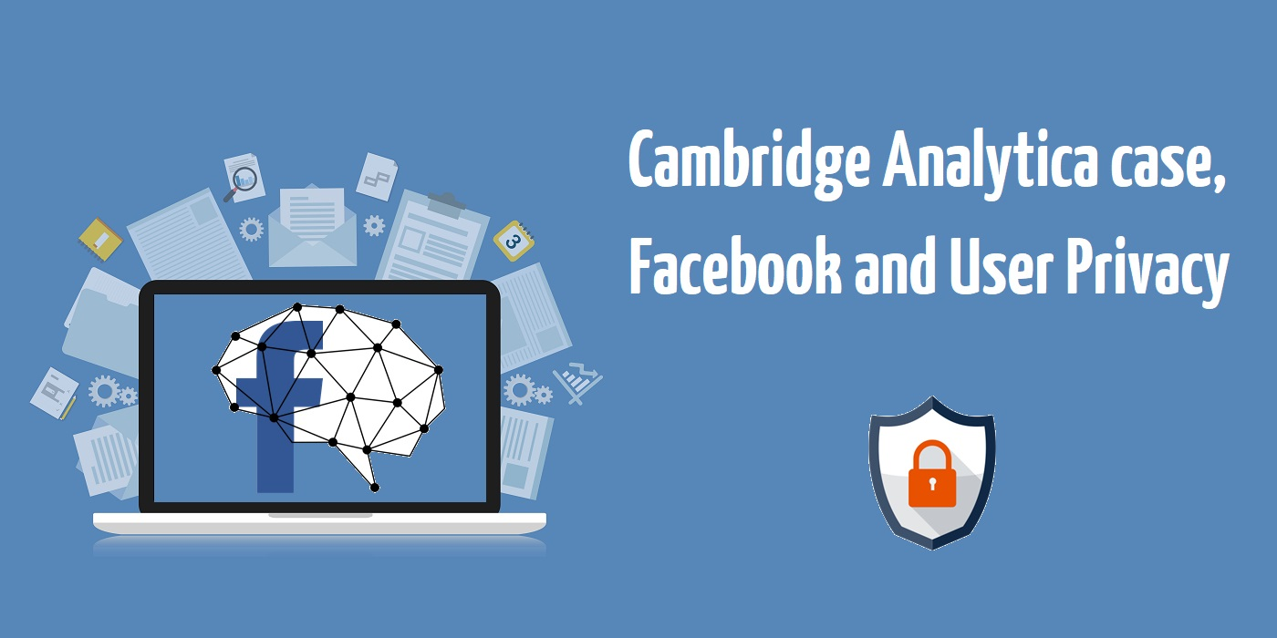
US Elections, Facebook, Cambridge Analytica and Russia
Lack of privacy can help others manipulate our behaviors.

Slide 6

What is Privacy?
Privacy is the user’s ability to control how data pertaining to him/her can be collected, used and shared by someone else.
Privacy is not a new problem
People have always worried about what others (friends, enemies, governments) might know about what they do.
What is different today?
Scale and magnitude at which information about us and our activities can be collected,
Ways in which it can be used, and shared or sold.

Slide 7
Do We Have Right to Privacy?
Privacy is a fundamental human right recognized in the UN Declaration of Human Rights, the International Covenant on Civil and Political Rights and in many other international and regional treaties.
Many countries in the world recognizes a right of privacy explicitly in their constitution
Qatar Personal Data Privacy Law (Law No 13 of 2016)

Slide 8
Lack of Data Privacy Risks
Individual inconveniences
Used to direct ad marketing campaigns
Identity theft
Help impersonate the victim
Provide info for social engineering attacks
Impact freedom of speech
Coercion and manipulation of behavior

Slide 9
Privacy in Today’s World
Data is collected on almost all actions and transactions that individuals perform
Web surfing, purchases, user surveys and questionnaires, and other sources
Data is then aggregated by data brokers
Used in various ways
Advertising, selling info, criminals, political adversaries, governments, etc.
Collected private data may be kept/abused indefinitely
Right to be forgotten

Slide 10
Data Brokers
Collect information about individuals from public records and private sources
Data are aggregated to create individual profiles, often made up of thousands of individual pieces of information
Associations with groups
Use of personal data to place individuals in groups based on similar interests
Statistical inferences
More in-depth than groupings
Notes:
Statistical inferences
Data from multiple sources can lead to information way beyond what we think
Sweeney, the governor and k-anonymity
Bitcoin and cryptocurrency
Profiles of brokers can have 1500 data points about a user (medical, personal, political, etc.)
Acxiom (US broker) claims to have files for 10% of the world population
Not only businesses (governments surveillance program ➔ Edward Snowden

Slide 11
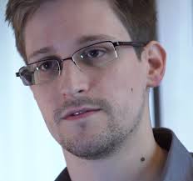
Government Surveillance Programs
Not only businesses such as brokers
Also Governments
NSA programs and Edward Snowden

Slide 12
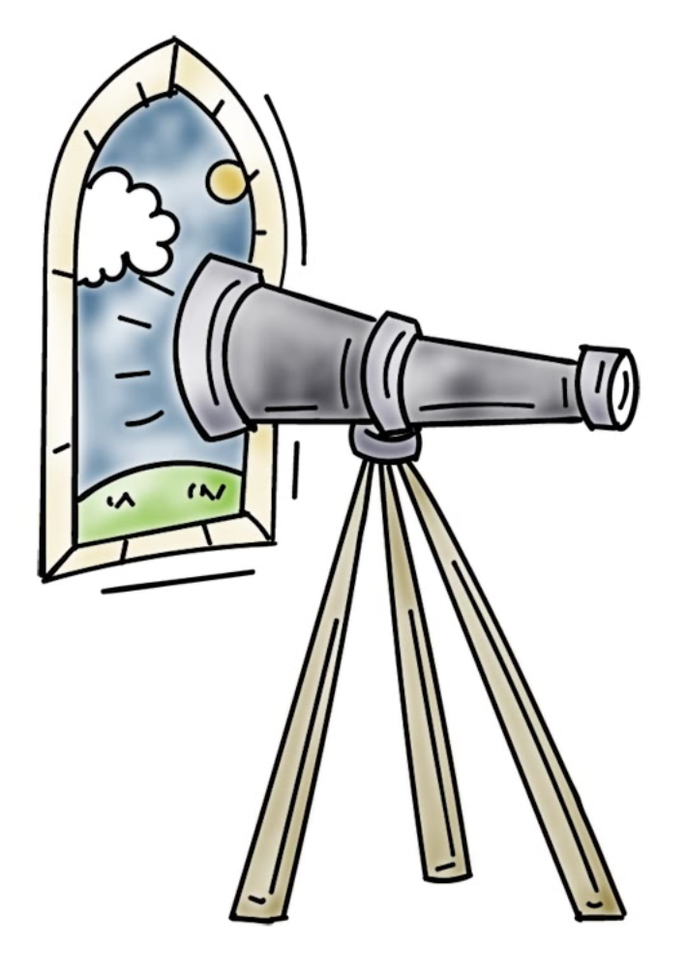
Threats to Privacy
Traffic analysis (we know who you talk to)
Surveillance (scale and magnitude – cameras everywhere, Snowden disclosures)
Linking and making inferences (big data, data mining, analytics)
Social media (we know your friends)
Tracking of web browsing (cookies)
Location aware applications (we know where you have been)
We are willing parties (loyalty cards in stores)

Slide 13
Components of Privacy Policy
Collection of information about you (e.g., tracking) – without your consent?
Usage – only used for specified purpose you agreed to?
Information retention – how long can they keep it?
Information disclosure and sharing – disclosed to only authorized or agreed to parties?
Privacy policy changes – can information holder change to a more lax policy without your agreement?
Information security – identity and access management, monitoring, protect your data against various security threats

Slide 14
Privacy Policy Examples
Google
Facebook

Slide 15

Example: Google Privacy Policy
What information is collected about you?
Personal info like name, email address, credit card, telephone number etc. that we provide to create an account. Profile?
Services we visit a certain a website. Use it for advertising.
Device information: hardware model, OS, network information (IP address) etc.
Search queries
Who we call? For how long we talk?
Cookies
Location

Slide 16
Example: Google Privacy Policy
How is collected information used?
Improve user experience (personalization)
For serving you targeted advertisements (this is how they make their money) – we can set ad preferences.

Slide 17
Example: Google Privacy Policy
Who do they share it with?
With opt-in, can share with companies, individuals and organizations outside of Google.
Domain administrators and resellers who provide user support to your organization can get certain information about you that you give to Google
Affiliates and other trusted businesses or persons with appropriate confidentiality and security measures
For legal reasons

Slide 18
Example: Google Privacy Policy
Data retention policy?
Recently added and regularly changes
You can delete some data whenever you like (e.g., content you created, activity info)
Other data is deleted or anonymized automatically after a set period of time, such as advertising data in server logs.
Some data until you delete your Google Account (e.g., how often you use services).
Some data is retained for legitimate business or legal purposes (e.g., security, fraud and abuse prevention, or financial record-keeping)

Slide 19
Example: Google Privacy Policy
Information security
Many services use encryption
Stronger authentication (two factor)
Other safeguards
Changes to privacy policy
Will not reduce user rights without your consent
Regularly reviewed and changed for compliance

Slide 20
Right to Be Forgotten Example
In 2014, the European Court of Justice ruled that EU citizens have the “right to be forgotten” on the Internet. For example, Google must not return links to information that can be shown to be "inaccurate, inadequate, irrelevant or excessive".
Which one of the following is an example of information that Google decided not to return as a search result to meet the ECJ ruling? Choose the best answer.
Story about criminal conviction that was quashed on an appeal
A doctor requesting removal of links to newspaper stories about failed procedures performed by him
✓
Notes:
QUIZ:
Discuss
---
SOLUTION:
Discuss

Slide 21

Companies Adherence to Privacy Policy
Do companies adhere and operate according to the privacy policy the user gave consent to?
Not really
Example: Facebook had issues and actually the US Federal Trade Commission went after it for violation of user privacy.
Mark Zuckerberg congress hearings

Slide 22
Facebook Privacy Policies
Examples of Facebook failure to adhere to the terms of user privacy policy?
Made information users designated as private public without consent (friend list)
Made personal information available to applications of friends
Shared information with advertisers that it had promised not to share
Verified apps were not really verified
Cambridge Analytica scandal (87 M accounts)
Recent: camera turned on while using FB
Other (see https://en.wikipedia.org/wiki/Criticism_of_Facebook)
Resulting FTC (US Federal Trade Commission) sanctions: E.g., 3rd party privacy audits every 2 years for the next 20 years

Slide 23
Data Protection Regulations
Address organizations’ responsibility to secure data against unauthorized access
Related to privacy: The ways organizations hold and handle private information

Slide 24
Responsibilities of Organizations
Collect only necessary personal information
Keep personal information only as long as necessary
Do not use personal information when it is not necessary
Restrict access to sensitive information
E.g., limit administrative access
Dispose of sensitive data securely
Use industry-tested and accepted standard methods for handling data
Comply with regulations

Slide 25
Data Protection and Privacy Law in Qatar
Law No 13 signed into las in 2016
The law has provisions related to the rights of individuals to protect the privacy of their personal data.
Covers electronically processed, obtained, or extracted data
Requires organizations to adhere to basic data protection responsibilities. This includes precautions to “protect personal data from loss, damage, modification, disclosure or being illegally accessed.

Slide 26
EU General Data Protection Regulation (GDPR)
Law on data protection and privacy for all individual citizens of the EU (enforced May 2018)
Consequential regulatory development
Applies to any enterprise established in EU or processes personal info inside EU.
Provisions and requirements related to the processing of personal data of individuals
Addresses the transfer of personal data outside the EU
Give control to individuals over their personal data

Slide 27
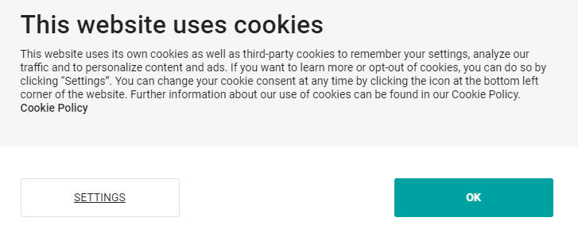
Example of GDPR Consequences: Cookies
You may have started seeing many cookie consent messages since May 2018 (GDPR enforcement date)
In GDPR: when cookies can identify an individual via their device, it is considered personal data
Implied consent is no longer sufficient
‘By using this site, you accept cookies’ messages are also not sufficient
No genuine and free choice, then
It must be as easy to withdraw consent as it is to give it.
Cannot just tell people block cookies if you do not want tem
Sites will need to provide an opt-out option

Slide 28
Controversial Discussion Points
Should governments have the right to citizens’ private information?
Surveillance programs
E.g. NSA programs revealed by Edward Snowden
Why should I worry? I have nothing to hide
Notes:
Should governments have the right to citizens’ private information?
Surveillance programs
E.g. NSA programs revealed by Edward Snowden
Why should I worry? I have nothing to hide
The people who why should I care, they do not believe it. Their actions negate this believe
They have passwords for their accounts
They have curtains on their windows
Eric Schmidt, Google CEO said: If you do something that you do not want other people to
know about, you probably should not be doing it in the first place.
But, Eric Schmidt requested his employees to stop speaking the CNET online magazine after
CNET published private information about him.
Eric Schmidt's Google blackballed CNet's reporters after CNet published personal information about Schmidt's private life: ""Google representatives have instituted a policy of not talking with CNET News reporters until July 2006 in response to privacy issues raised by a previous story..." "To underscore its point about how much personal information is available, the CNET report published some personal information about Google's CEO Eric Schmidt -- his salary; his neighborhood, some of his hobbies and political donations -- all obtained through Google searches....“
Hey, Eric: if you don't want us to know how much money you make, where you live, and what you do with your spare time, maybe you shouldn't have a house, earn a salary, or have any hobbies, right?
Edward Snowden: "Arguing that you don't care about the right to privacy because you have nothing to hide is no different than saying you don't care about free speech because you have nothing to say.
Are governments trustworthy. If they are today, how about tomorrow?

Slide 29
References
Internet privacy
https://en.wikipedia.org/wiki/Internet_privacy
EU General Data Protection Regulation (GDPR)
https://en.wikipedia.org/wiki/General_Data_Protection_Regulation
Security in Computing, Charles P. Pfleeger (Author), Shari L. Pfleeger, 5th Edition, Prentice Hall, 2015. (Chapter 9)
Privacy issues of Facebook
https://en.wikipedia.org/wiki/Criticism_of_Facebook
Tor
https://en.wikipedia.org/wiki/Tor_(anonymity_network)
https://www.torproject.org/download/ [not accessible in Qatar]
Examples of privacy policies
Google: https://policies.google.com/privacy?hl=en-US
Facebook: https://www.facebook.com/full_data_use_policy
Nothing to hide argument
https://en.wikipedia.org/wiki/Nothing_to_hide_argument

